Slide 1
STS 20GPM Pump Analysis
Analysis By:
Henry Kimeu & Kibet Rotich

Slide 2
Issue Definition
What We Know
Pump Issue Analysis
Root cause
Summary and recommendations

Slide 3
Issue Definition
This is an investigation into the increased error 092(Pump low flow rate) that have been reported. STS pumps have been reported to exhibit low flow rate and sometimes pump malfunction during KP refills.
Goal:
To establish the root cause for these pump issues and come up with recommendations to mitigate this problem on short term and long term basis.

Slide 4
What We Know
Error 092 (pump low flow rate) was experienced in March at an increased frequency for all the trucks.
3 pumps have been replaced in STS so far. 2 of these were damaged beyond repair and were replaced under warranty. One was repaired by replacing vanes.
Current maintenance team resolution is to clean blockage, dusting pump cavity to remove carbon dust, replacement of pump fuse and replacing worn out vanes where appropriate guided by troubleshooting guide.

Slide 5
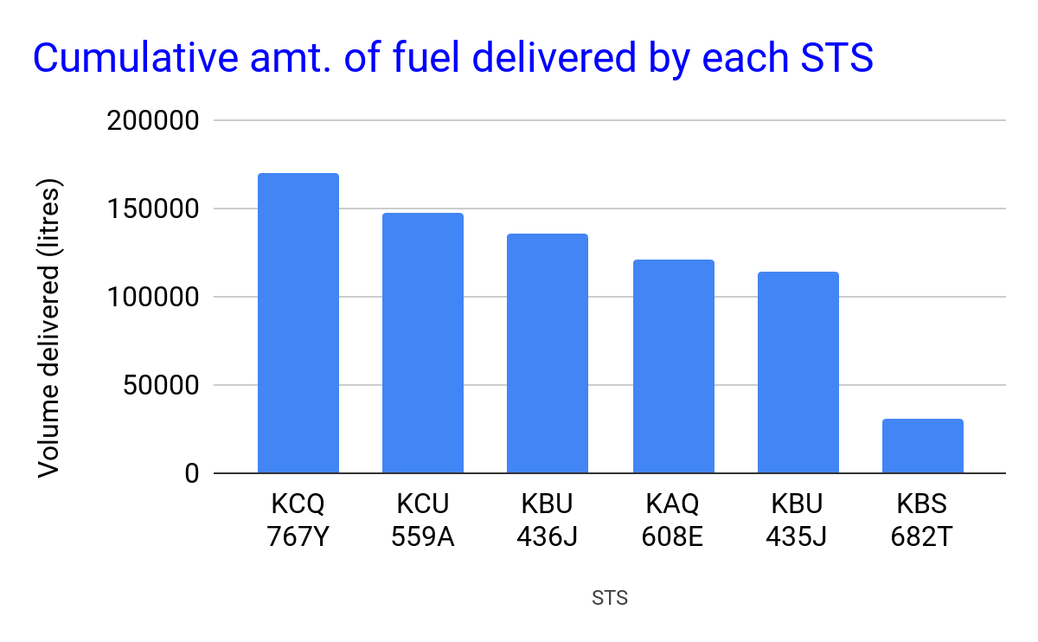
Delivered Volume (Liters)
Volume delivered to KOKOpoints by each of the tankers since commissioning in 2019.
STS | 2019 | 2020 | Overall | Totalizer
KAQ 608E | 60,347 | 60,687 | 121,034
KBU 435J | 26,699 | 74,797 | 101,496 | 114031
KBU 436J | 35,837 | 90,111 | 125,948 | 135,414
KCQ 767Y | 50,722 | 96,247 | 146,969 | 169,765
KCU 559A | 46,115 | 87,189 | 133,304 | 147,375
KBS 682T | 27,504 | 3,451 | 30,955 | 30598
NB: Data source Tableau - Operations Fuel (2019 - 6th May 2020)

Slide 6
Replacement Parts Cost Analysis
We lost an average deliveries of 60,000 liters between the months of March and May 2020 due to identified tanker interruptions
Part Name | Frequency | Total cost
20GPM Pump | 4 | Replaced warranty
200Ah Battery | 3 | $808.89
40A Fuse | 7 | $0.63
Charging port | 1 | $7.49
Strut | 1 | $16.01
MRBF 30A | 1 | $38.64
MRBF 40A | 2 | $76.90
Pump Vanes | 2 | $98.76
Total service costs |  | $1,047.32
Total litres delivered (prev slide) |  | 659,706
Opex cost per litre delivered |  | $0.0016
NB: Central Bank of Kenya Forex rates on 15th May 2020)

Slide 7

Pump Issue Analysis
Issue occurrence trends
Distribution of issues across micro-tankers
Current resolutions applied

Slide 8
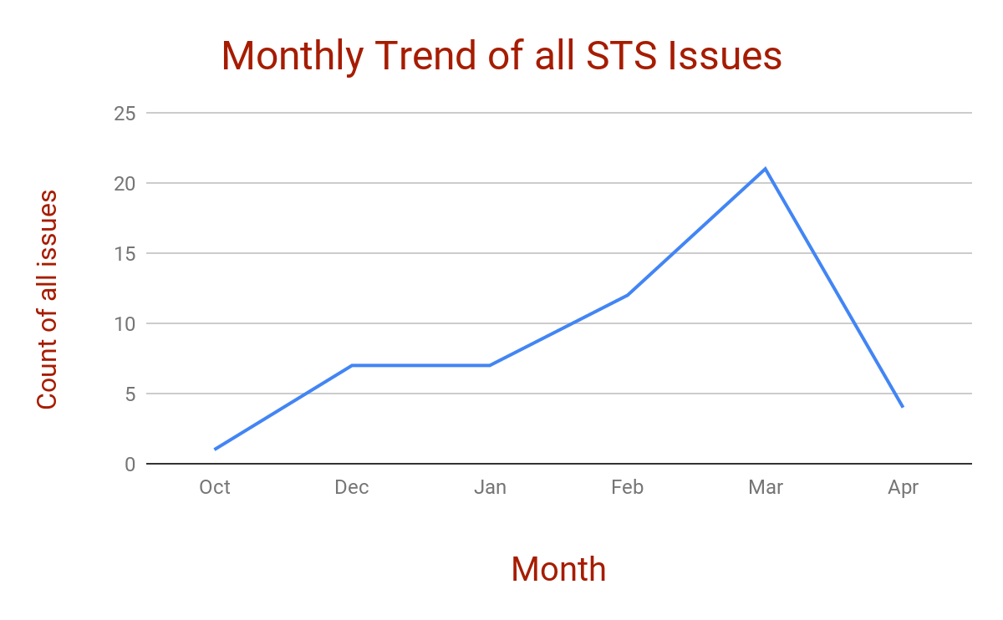
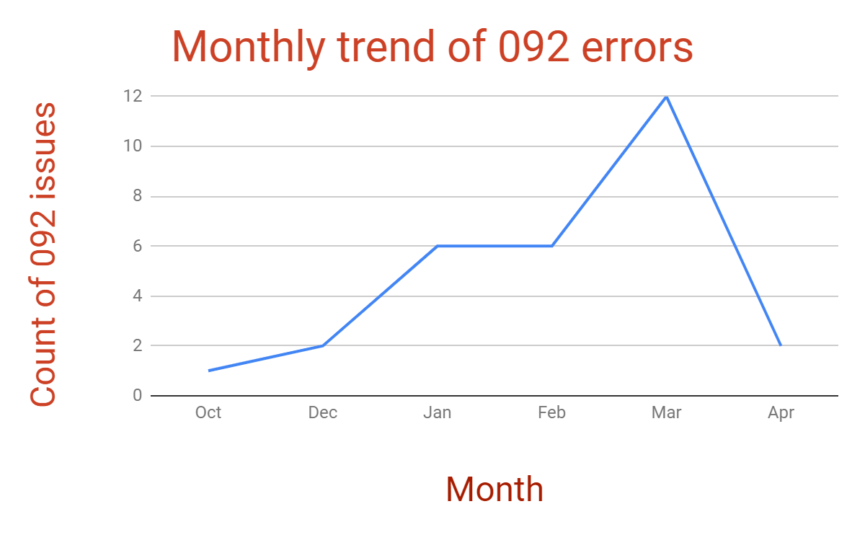
Analysis: Monthly Trends
Issues have been increasing with time including error 092.
Number of fuel deliveries per month have been increasing due to increased customer fuel consumption

Slide 9
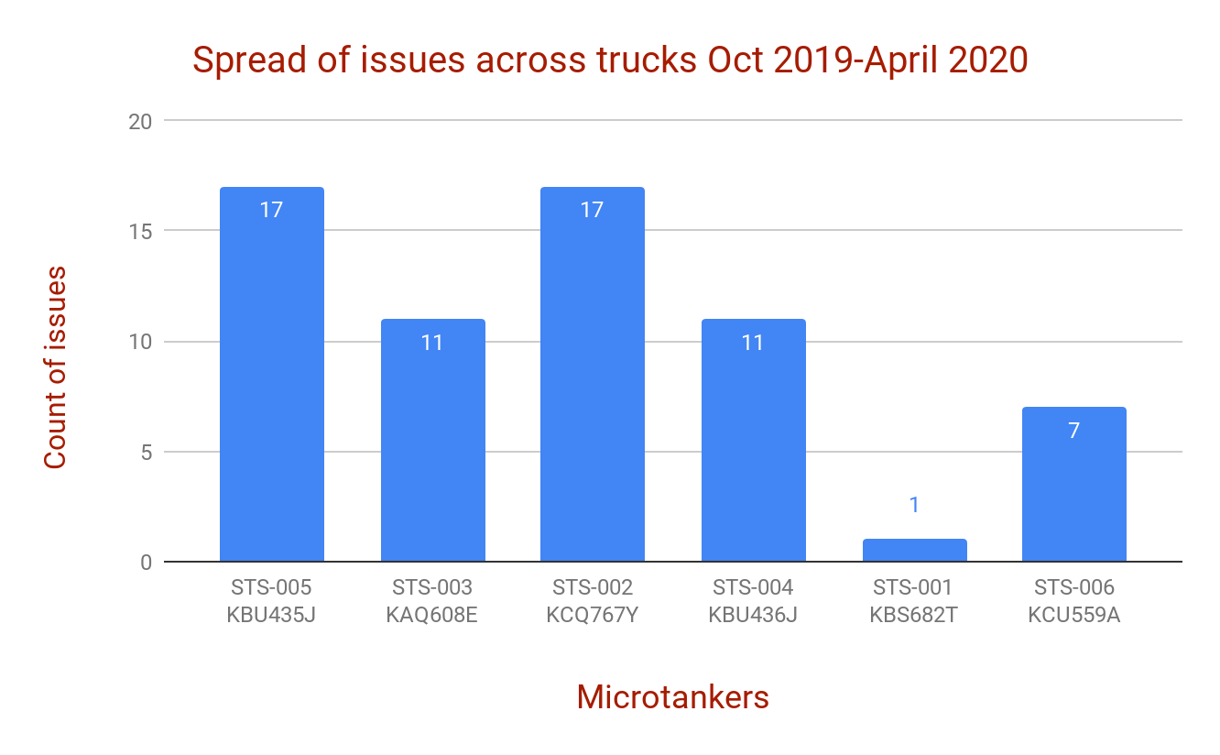
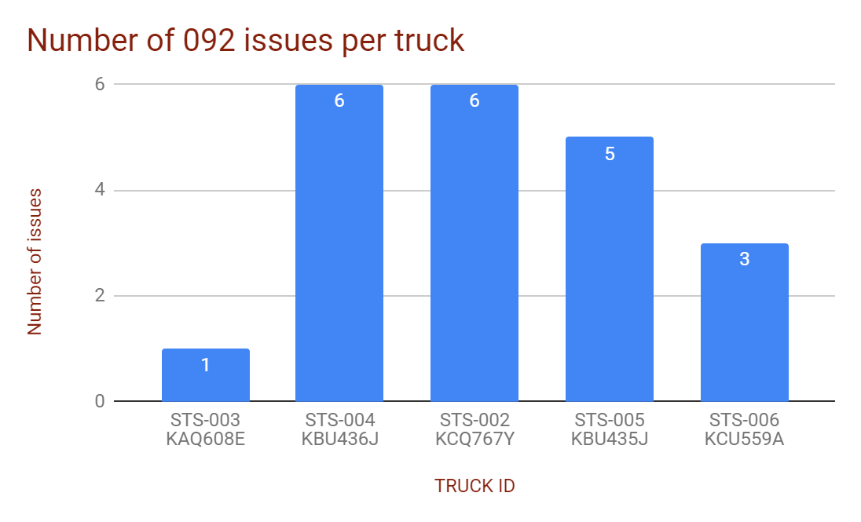
Issue Distribution Across Tankers
STS 005 and STS 002 lead in reported issues.
STS 001 is rarely used for KP refills.
STS 002 pump was replaced on 5th Mar, after which only one 092 issue occurred to date.
Both STS 002 & STS 004 have had repetitive cases of dust accumulation in pump cavity.

Slide 10
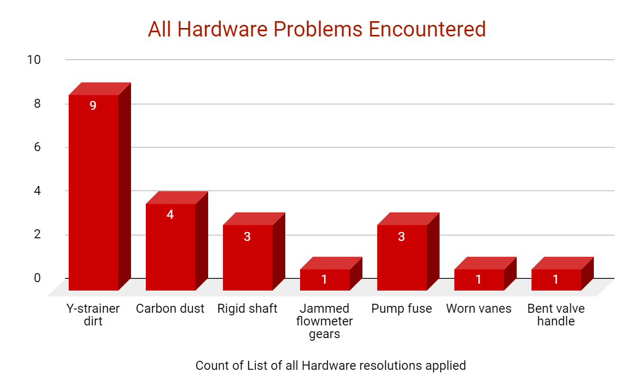
Hardware Issues & Current Resolutions
Other than clearing error codes, issue resolution currently applied by maintenance team includes;
Cleaning pump upstream Y-strainer
Cleaning flow meter upstream Y-strainer
Cleaning pump filter
Unjamming flowmeter gears
Replacing vanes
Replacing blown fuse
Cleaning carbon dust in pump cavity
Removing kinks in pump upstream hose
Replacing pump
Straightening bent valve handles which prevent full actuation of valve,
Hardware problems encountered so far are spread out as below;

Slide 11
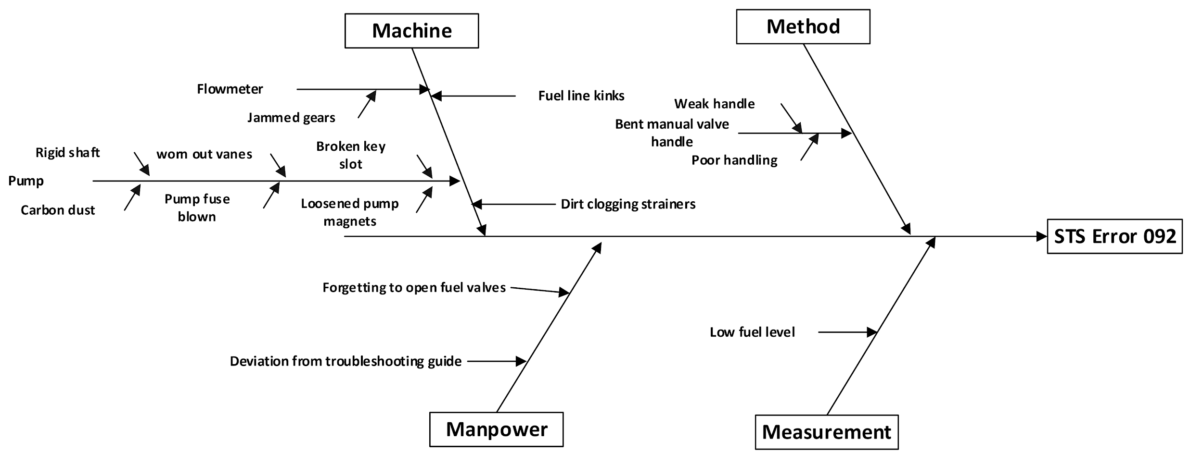
Cause and Effect Diagram

Slide 12
Root Cause Prioritization Matrix
 | Potential Root Cause | Probability of occurrence | Severity level | Ease of detection | Cumulative scale | Recommendations
1 | Dirt clogging Y strainers | 5 | 4 | 2 | 40 | Consider testing use of bigger filter model that can contain more dirt. Review frequency of cleaning Y strainer.
2 | Worn out pump vanes Broken key slot | 3 | 4 | 3 | 36 | Currently have replacements in stock
3 | Carbon dust in pump cavity | 3 | 4 | 3 | 36 | Consider testing new model manufacturer mentioned that it will be available in April
4 | Loosened pump magnets | 2 | 5 | 3 | 30 | Consider new pump with better magnet mounting
5 | Rigid pump shaft | 3 | 4 | 2 | 24 | Consider new pump which can be lubricated
6 | Jammed flowmeter gears | 2 | 5 | 2 | 20 | Consider sourcing different 100 mesh filter/strainer model
7 | Bent manual valve handles | 4 | 3 | 1 | 12 | Replace with different valve model
8 | Kinks in pump inlet hose | 3 | 3 | 1 | 9 | Replace flexible hose with reinforced but easy to route model
9 | Blown pump fuse | 2 | 4 | 1 | 8 | Buy adequate replacements/Use resettable load overcurrent trip breaker
10 | Low fuel level | 2 | 2 | 1 | 4 | Prevent dispense/scheduling below min. threshold.

Slide 13
Summary and Recommendations
Short term
Test/evaluate evaluate using bigger filter to reduce frequency of filter clogging.
Stock adequate pump fuse, vanes and key slot.
Source different valve model.
Evaluate sourcing 100 mesh flow meter upstream Y-strainer
Test/Evaluate using reinforced but flexible pump inlet hose to avoid kinks.
Long term
Evaluate new pump model with sturdy magnet mounting, less carbon dust, and long lasting bearings(which can be lubricated).

Slide 14
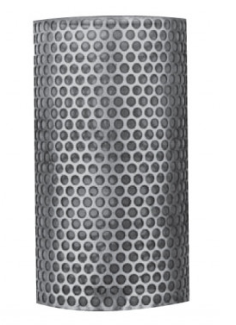
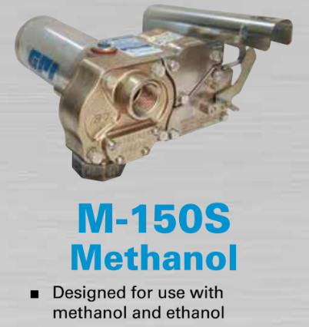
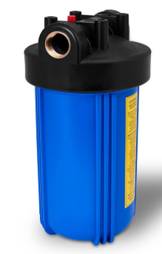
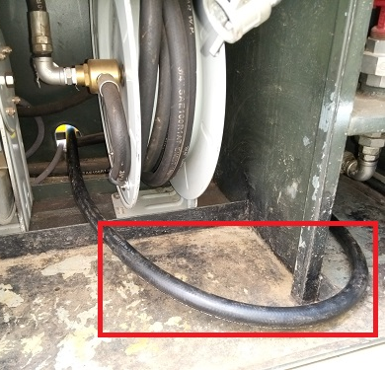
APPENDIX: Recommendations
100mesh filter for Y-Strainer
Bigger sized filter for pump inlet
Flexible but reinforced hose: no kinks
Alternative pump

Slide 15
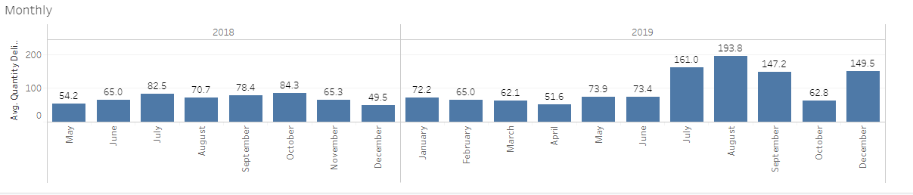
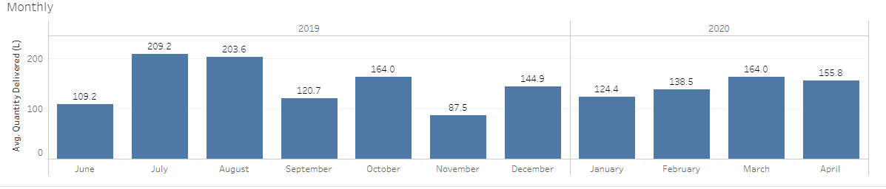
APPENDIX: Monthly Average Refill Volume
Monthly average refill volume
KBS682T
KCQ767Y

